Slide 1

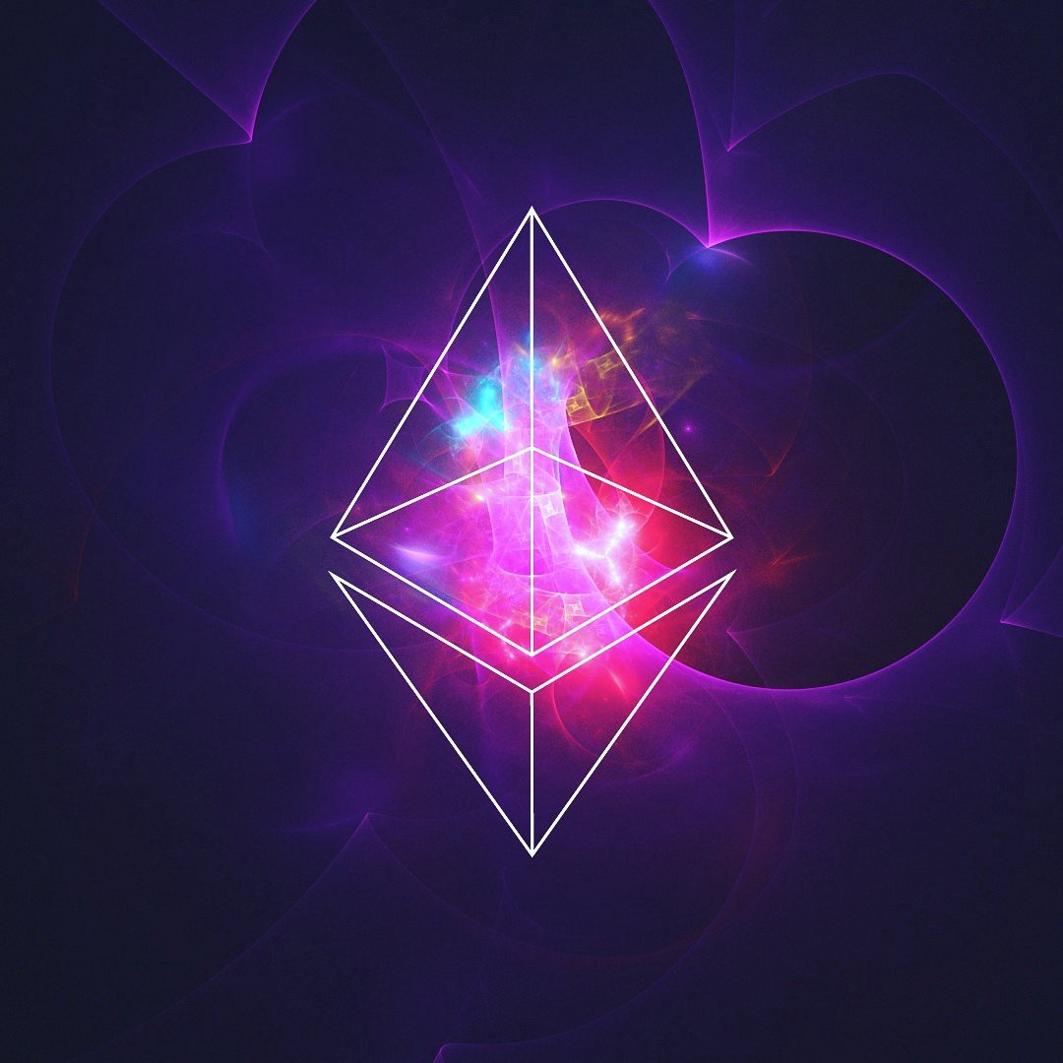
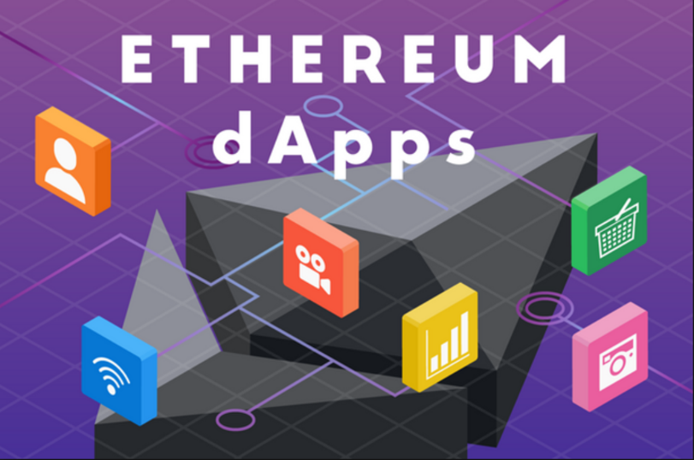
WEEK 4
WEEKLY STATUS REPORT
IoT Blockchain and its applications in Logistics
Mentor: Nguyen Xuan Thong
Reporter: Thanh Tung – Thanh Phuong

Slide 2
INTRODUCE ABOUT WEB3.JS
01
Web2.0 & Web3.0
Web3.js
ABOUT JSON RPC
02
RPC
JSON RPC
CONTENTS
03
TRUFFLE – GANACHE – DRIZZLE & META MASK
Truffle
Ganache + Meta Mask (manage wallet)
Drizzle
04
BUILDING DAPPS
Schematic & The process
Expand using NodeJS with Raspberry Pi

Slide 3


01 INTRODUCE ABOUT WEB3.JS
Web2.0 & Web3.0
Web3.js

Slide 4
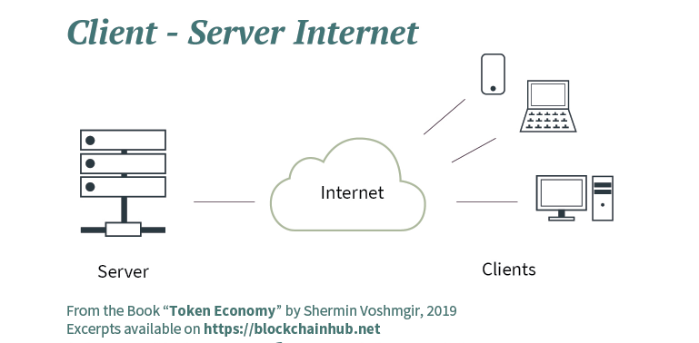
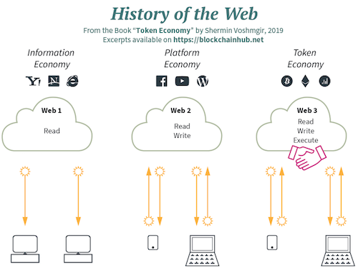
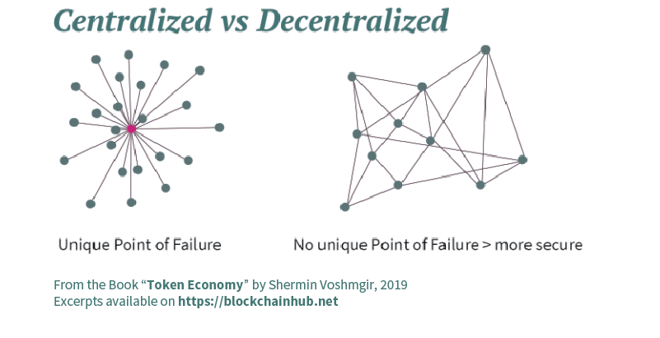
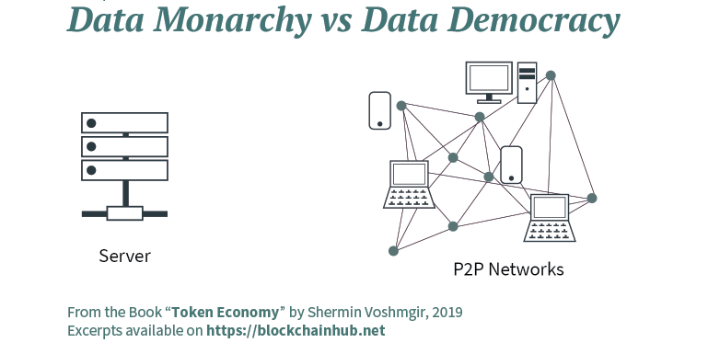

Slide 5
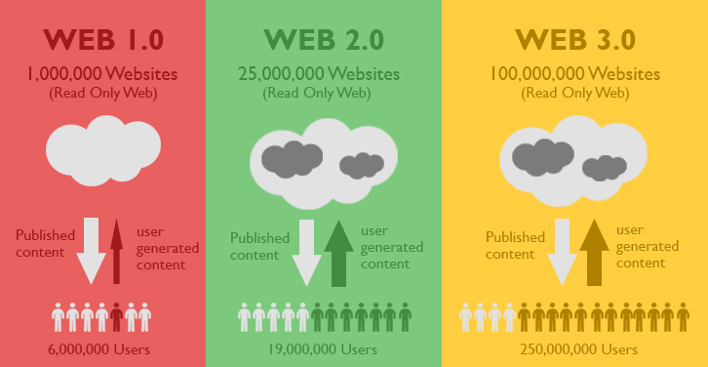
Before 2000
2000 – 2010
2010 – 2020

Slide 6
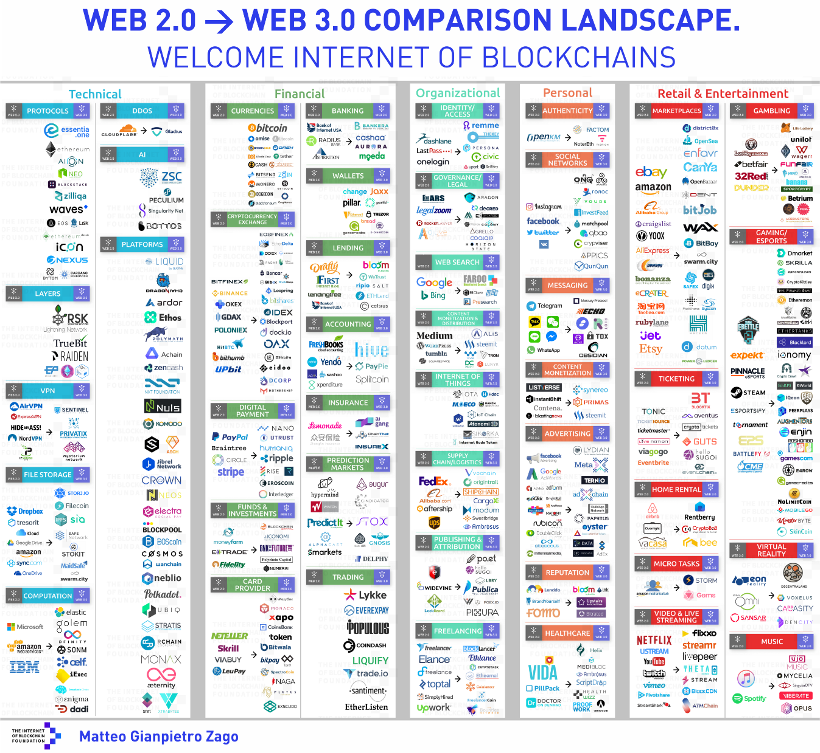

Slide 7
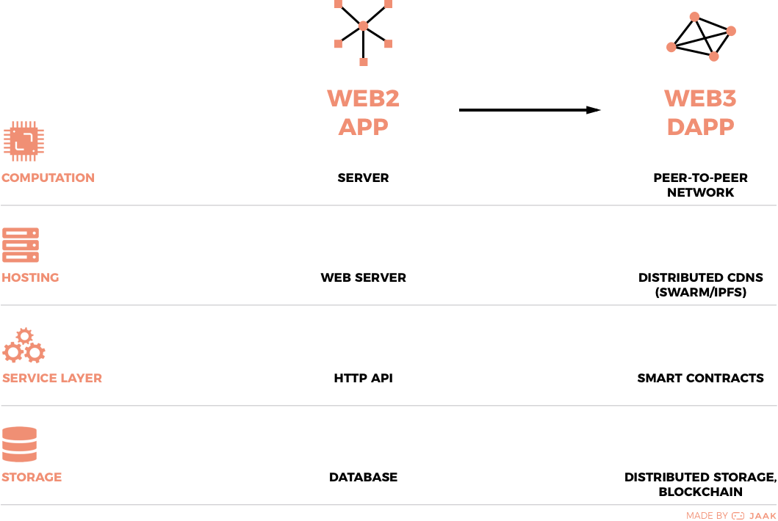

Slide 8
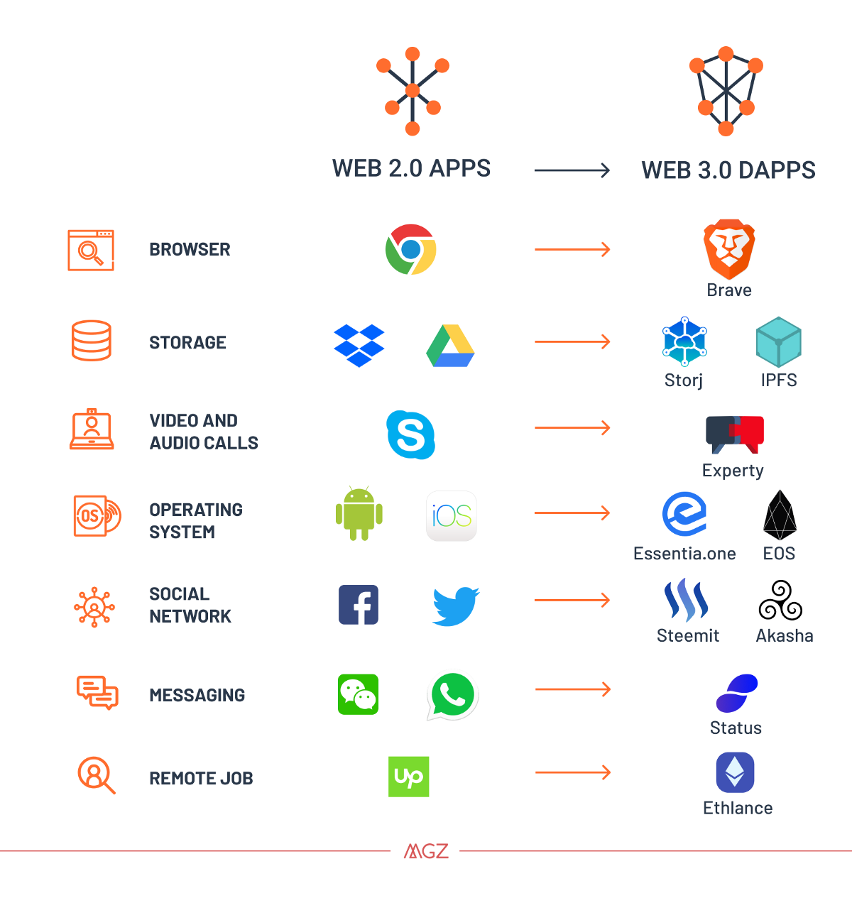

Slide 9
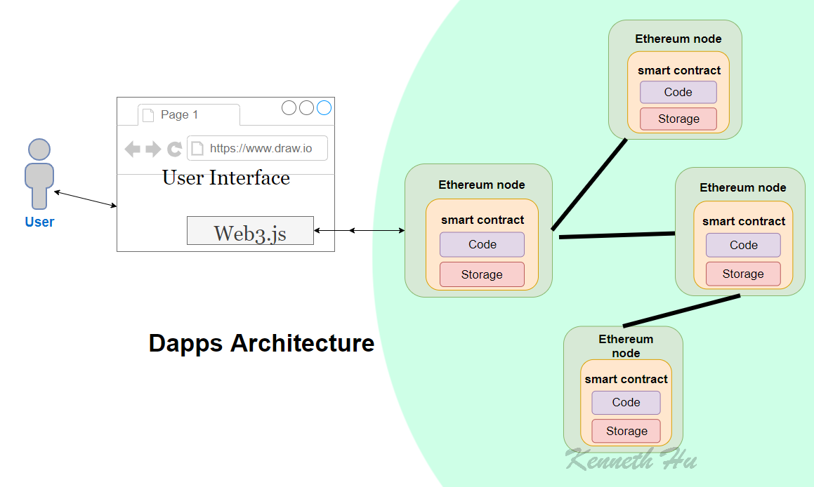
web3.js is a collection of libraries which allow you to interact with a local or remote ethereum node, using a HTTP or IPC connection.

Slide 10

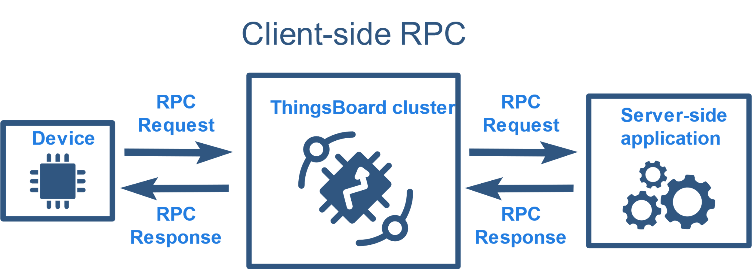
02 ABOUT JSON RPC
RPC
JSON RPC

Slide 11
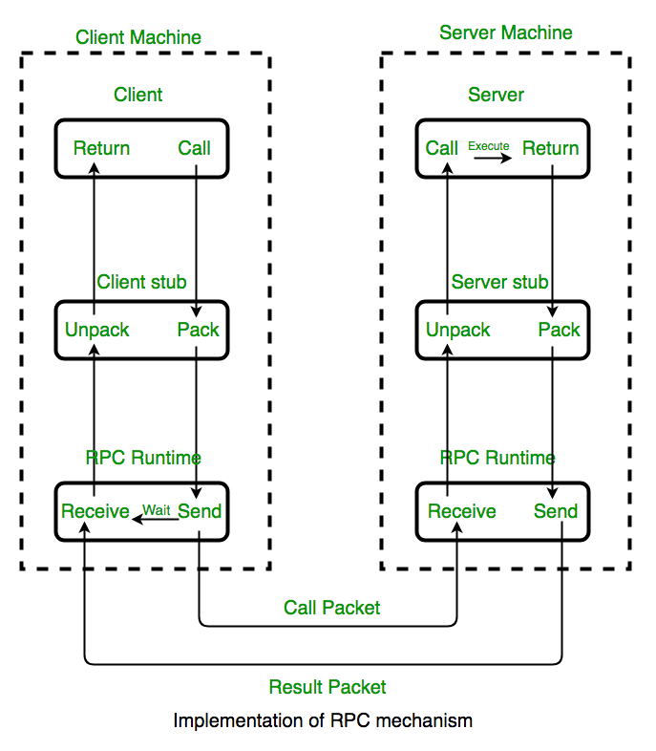
WHAT IS RPC ?
What is RPC?
In distributed computing, a remote procedure call (RPC) is when a computer program causes a procedure (subroutine) to execute in a different address space (commonly on another computer on a shared network).
Additional information:
Remote Procedure Call (RPC) is a powerful technique for constructing distributed, client-server based applications. It is based on extending the conventional local procedure calling, so that the called procedure need not exist in the same address space as the calling procedure. The two processes may be on the same system, or they may be on different systems with a network connecting them.

Slide 12
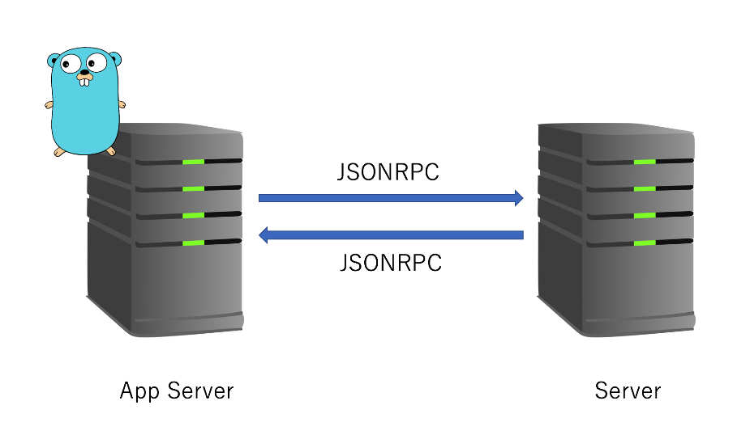
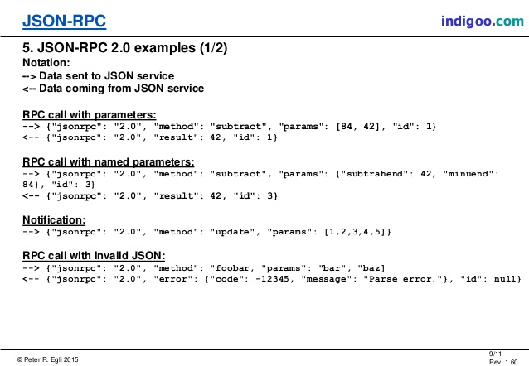
JSON RPC
Ethereum JSON RPC
JSON is a lightweight data-interchange format. It can represent numbers, strings, ordered sequences of values, and collections of name/value pairs.
JSON-RPC is a stateless, light-weight remote procedure call (RPC) protocol. Primarily this specification defines several data structures and the rules around their processing. It is transport agnostic in that the concepts can be used within the same process, over sockets, over HTTP, or in many various message passing environments.
JavaScript API
To talk to an ethereum node from inside a JavaScript application use the web3.js library, which gives an convenient interface for the RPC methods. See the JavaScript API for more.

Slide 13
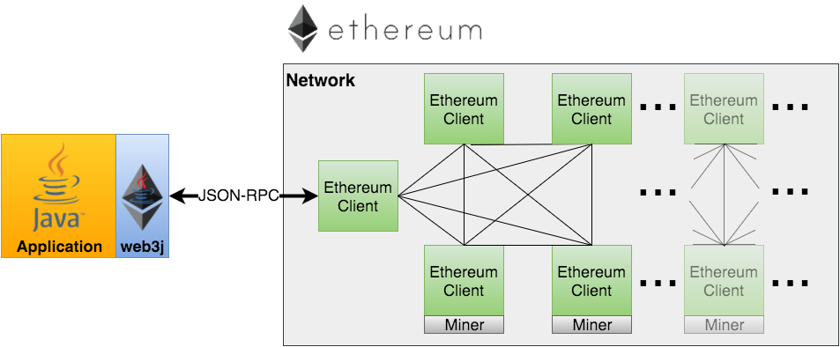
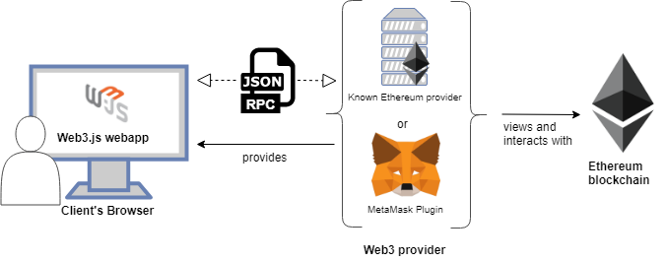

Slide 14


03 TRUFFLE – GANACHE – DRIZZLE & META MASK
Truffle
Ganache + Meta Mask (manage wallet)
Drizzle

Slide 15
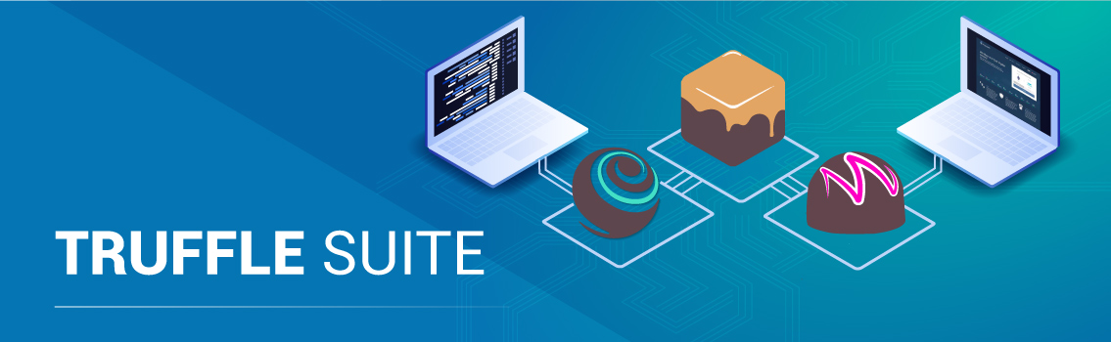
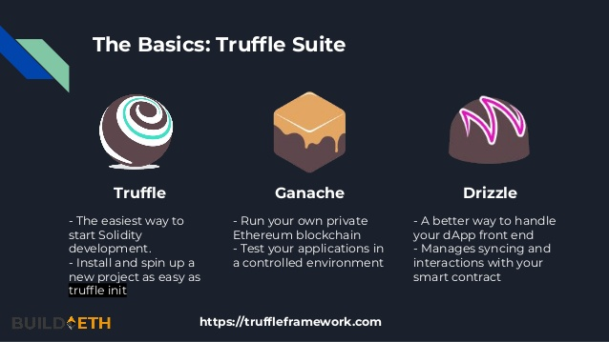

Slide 16
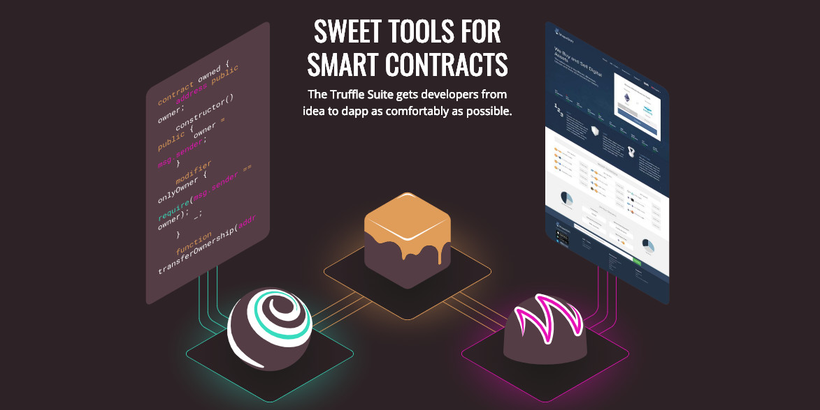

Slide 17
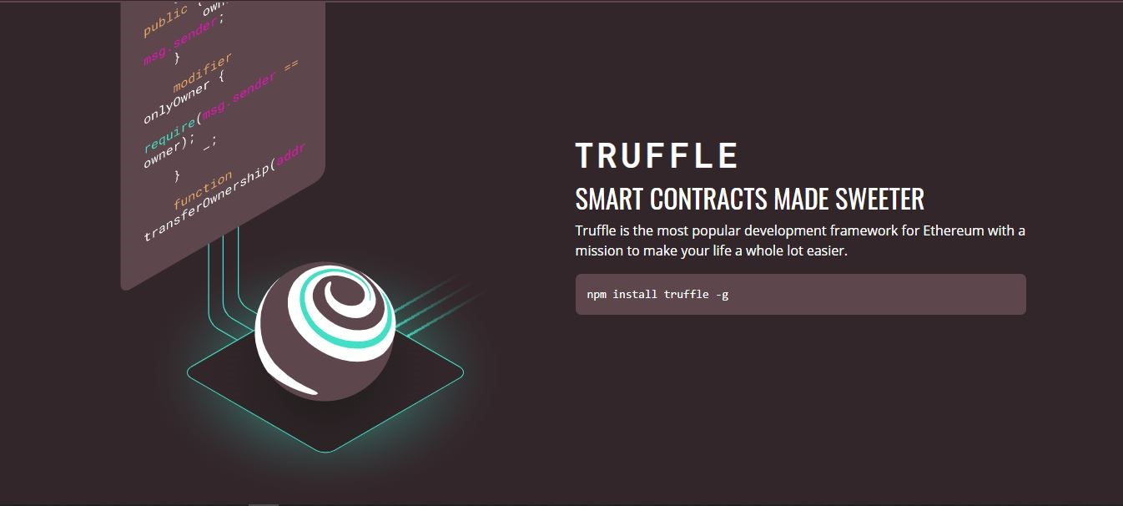

Slide 18
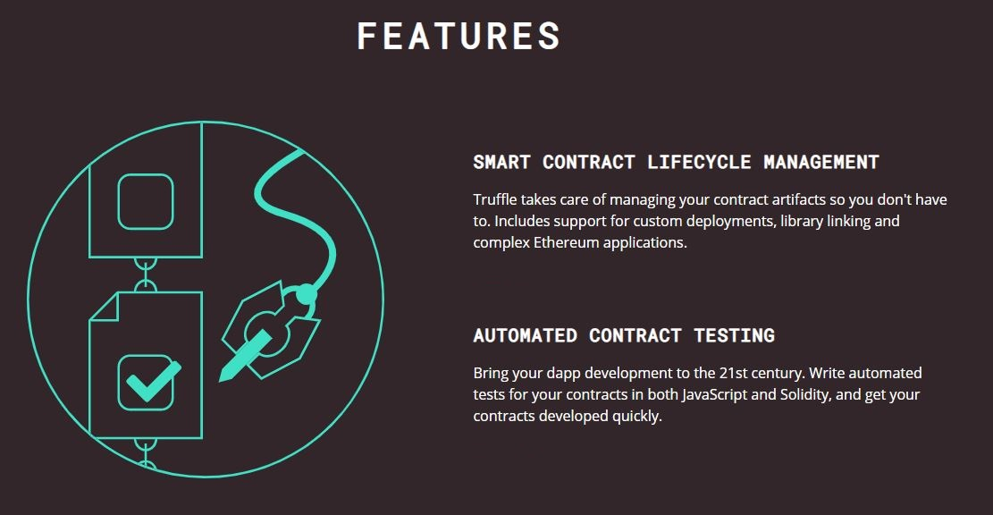

Slide 19
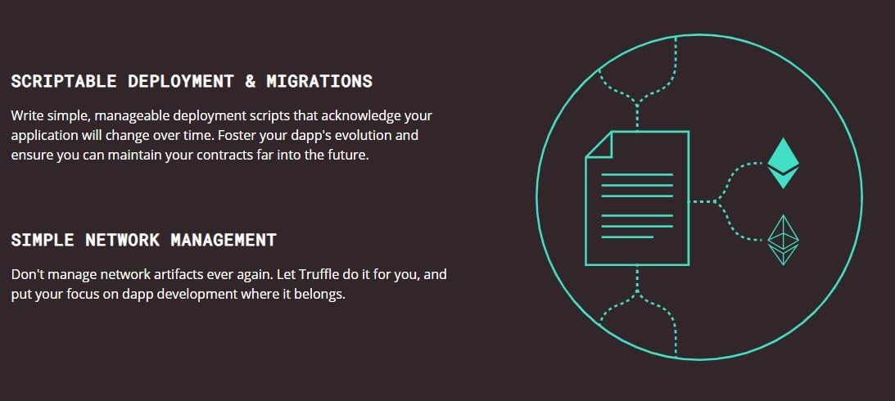

Slide 20
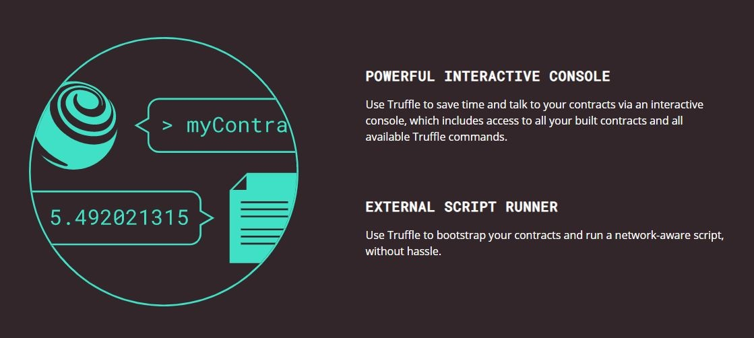

Slide 21
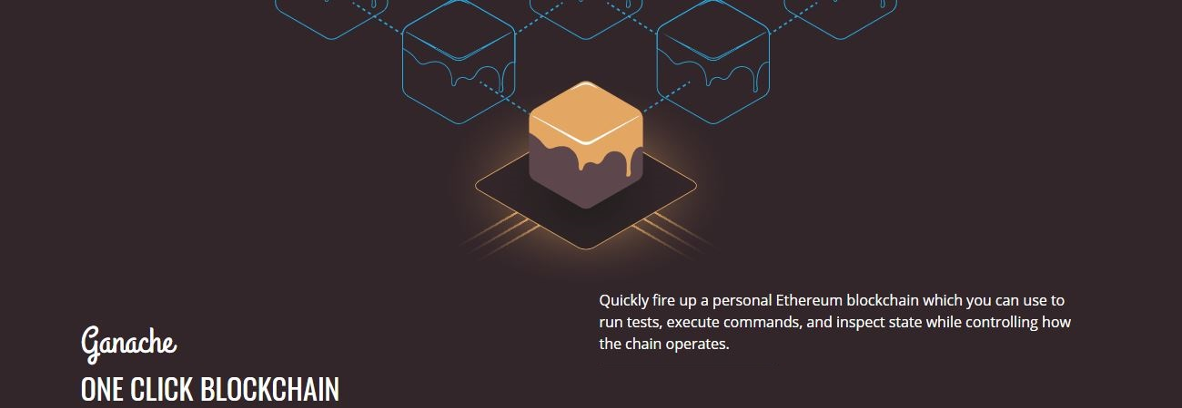

Slide 22

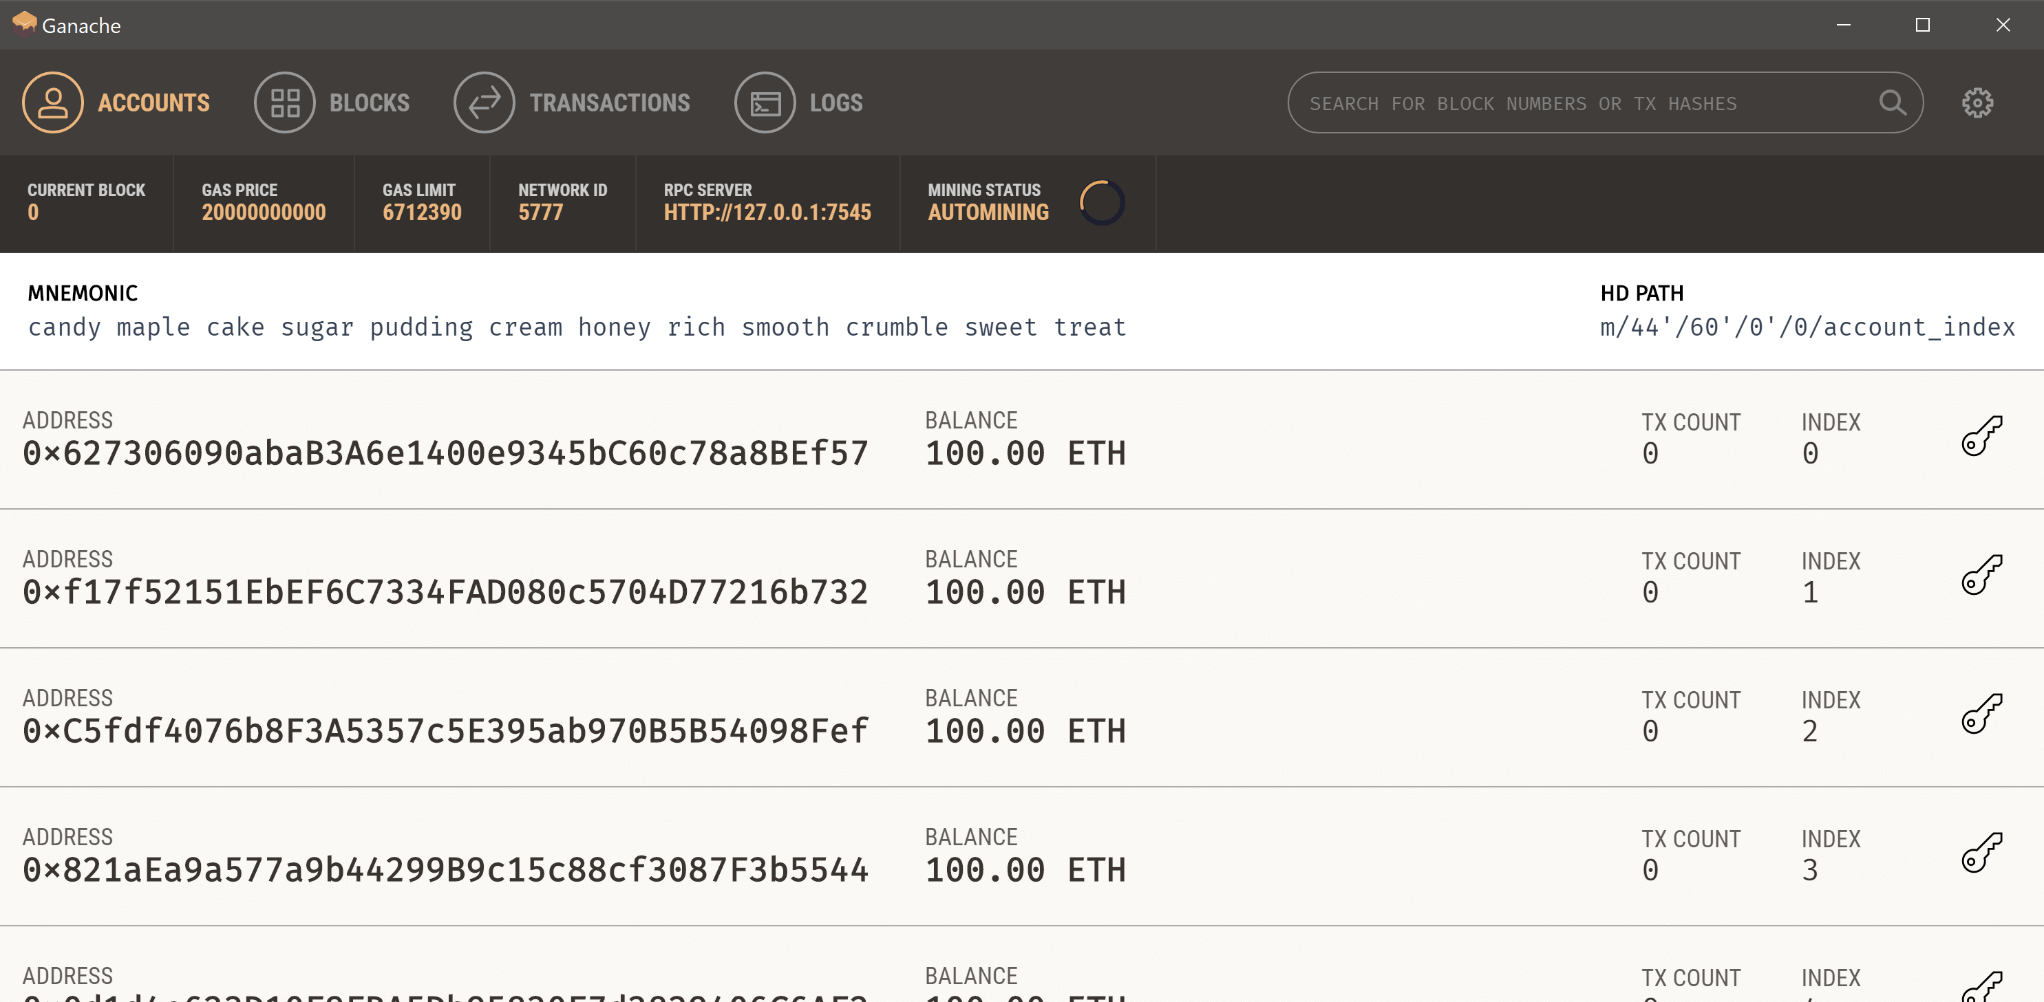

Slide 23
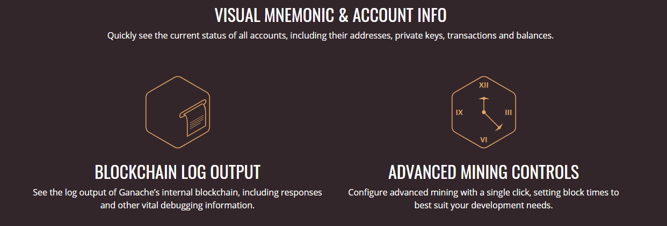
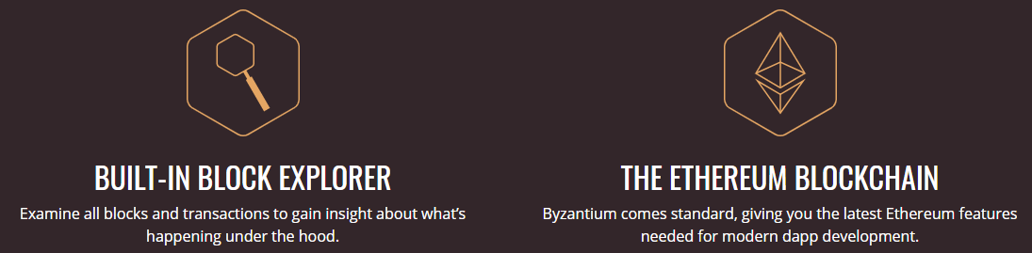

Slide 24
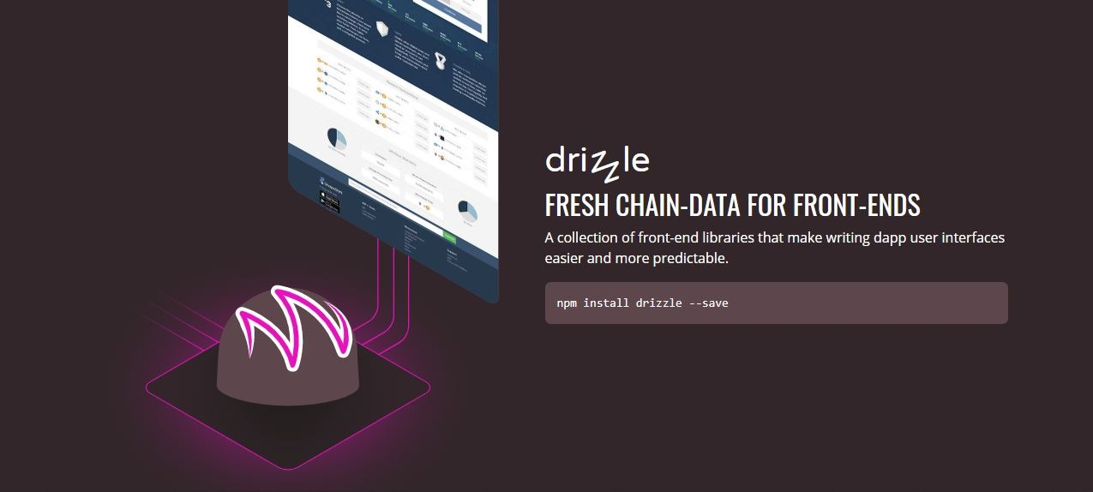

Slide 25

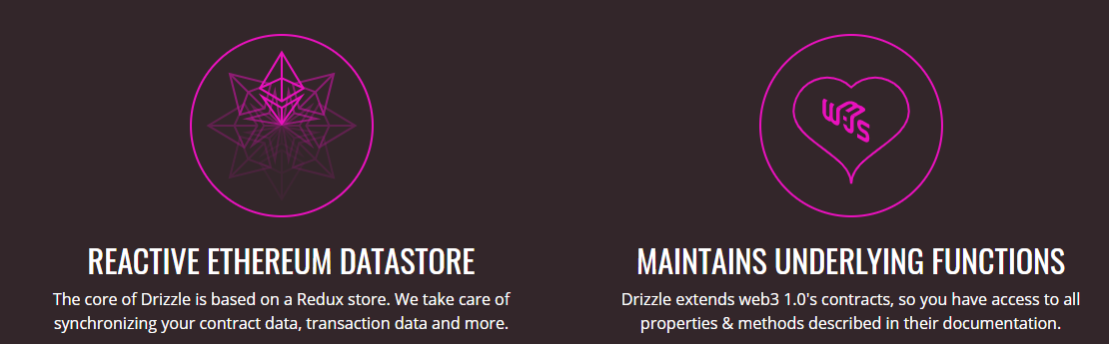
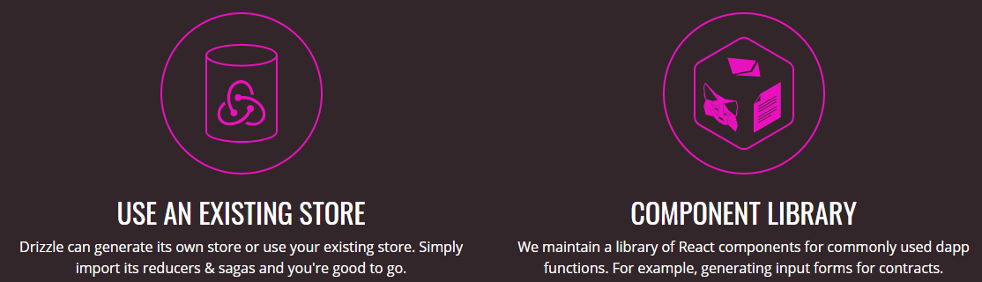

Slide 26

What is Meta Mask?
MetaMask is an easy-to-use browser plugin (for Google-Chrome, Firefox and Brave browser), that provides a graphical user interface to make Ethereum transactions. It allows you to run Ethereum DApps on your browser without running a full Ethereum node on your system. Basically, MetaMask acts as a bridge between Ethereum Blockchain and the browser. MetaMask is open-source and provides the following exciting features:
You can change the code of MetaMask to make it what you want it to be
Provides built-in coin purchasing
Local-key Storage

Slide 27
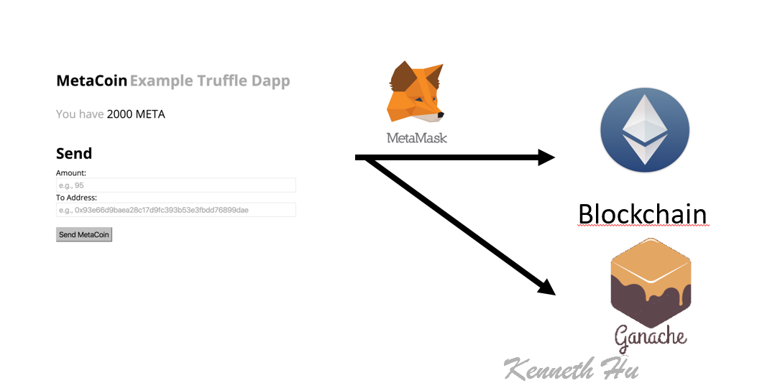

Slide 28
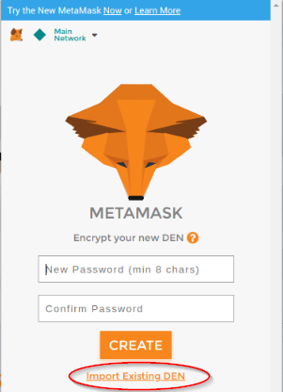
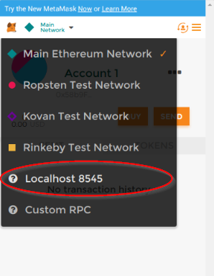
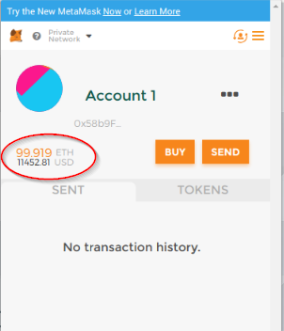
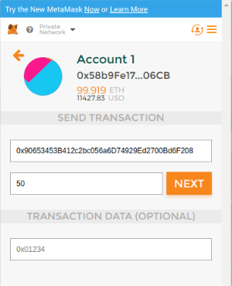
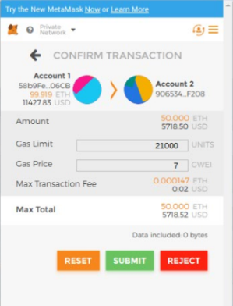
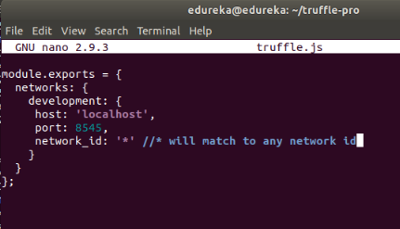
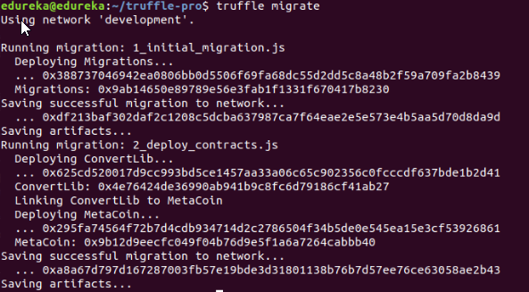

Slide 29
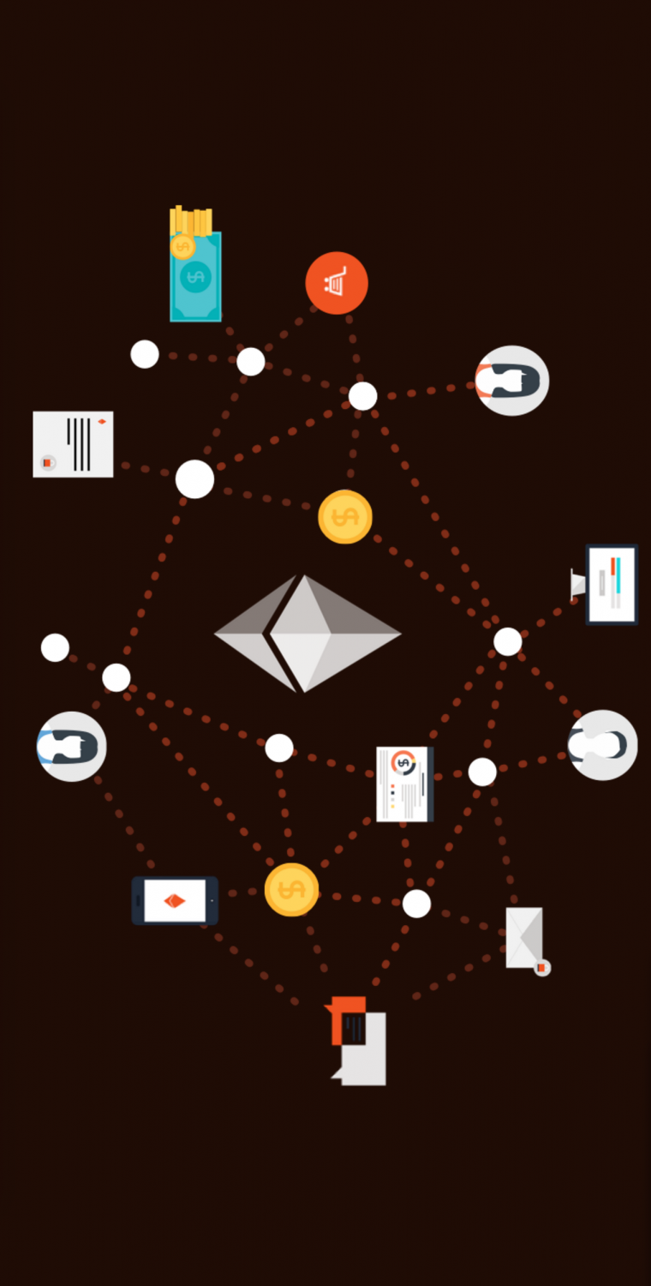
04 BUILDING DAPPS
Schematic & The process
Expand using NodeJS with Raspberry Pi

Slide 30
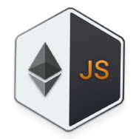




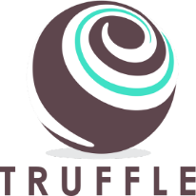
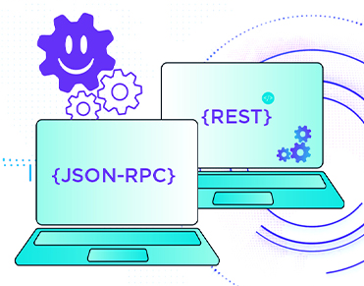
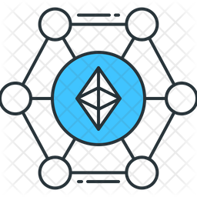
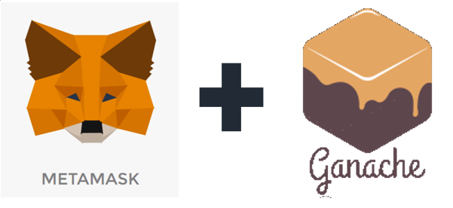
Ethereum JavaScript API
Smart Contract
based on
file smartcontract.sol
file .js
config.js
Web3.js
Web3.js
form & locate
connect
port / host key
Ethereum Blockchain for developer
JSON RPC
port / host key EthBlockchain
manage accounts / wallets
create
transact

Slide 31
STEP BY STEP – FOR TESTING OF PREVIOUS WEEK
01
Install needed parties
02
Write – Test – Deploy Smart Contract
(Web3, JSON RPC, …)
03
04
Migrating Smart Contract
Instantiating web3.js & Smart Contract
Handle function with UI
05
06
(updated, …)
Interacting with Dapp in a browser
Using Meta Mask
07
08
Link Meta Mask with the EtheBlockchain network
Create a Lite-Server to control DApp

Slide 32

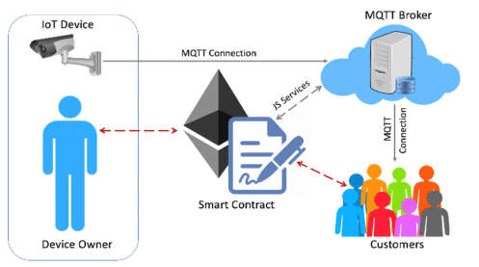
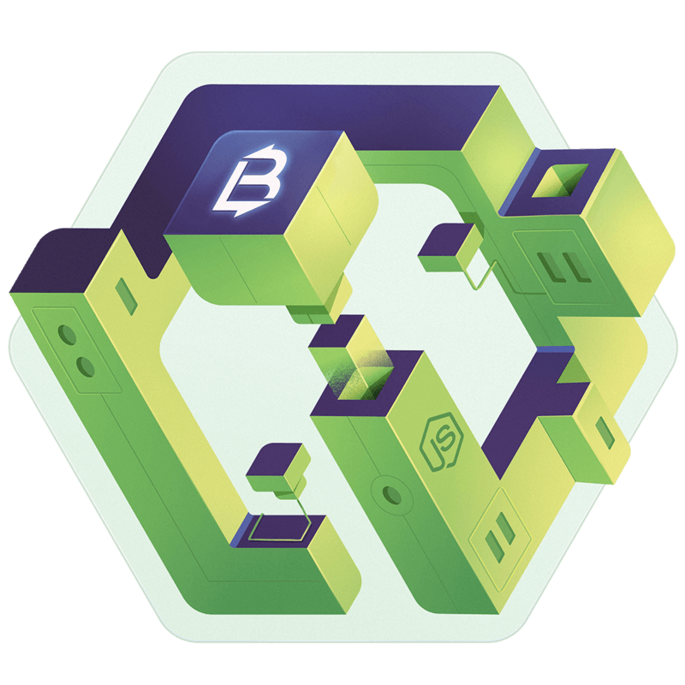
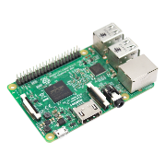

STEP BY STEP – FOR REALITY PROCESSING
Create a solidity contract.
Deploy Smart Contract to an Ethereum Blockchain network.
Write a small NodeJS application and connect to the blockchain network via Web3.js (Ethereum JavaScript API).
Start NodeJS application on Raspberry Pi.

Slide 33
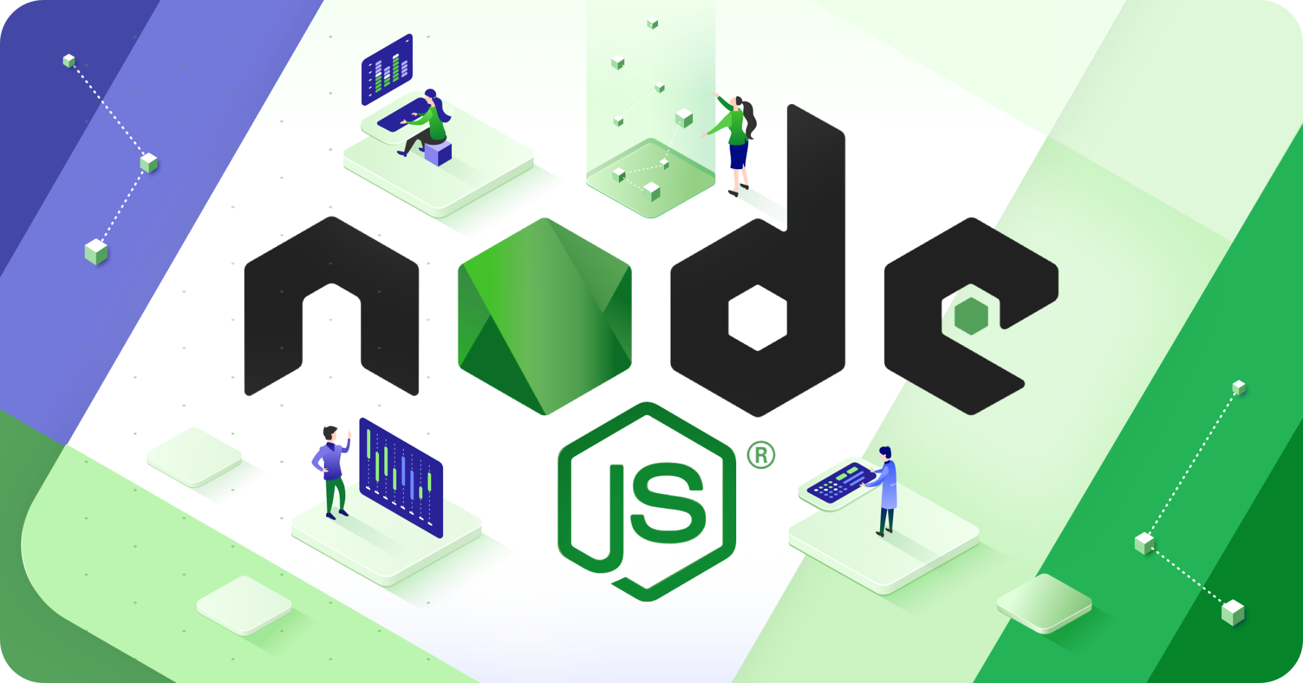

Slide 34
THANK YOU FOR YOUR LISTENING

